Slide 1
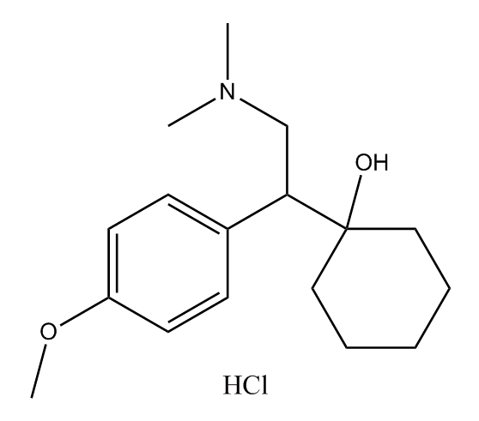
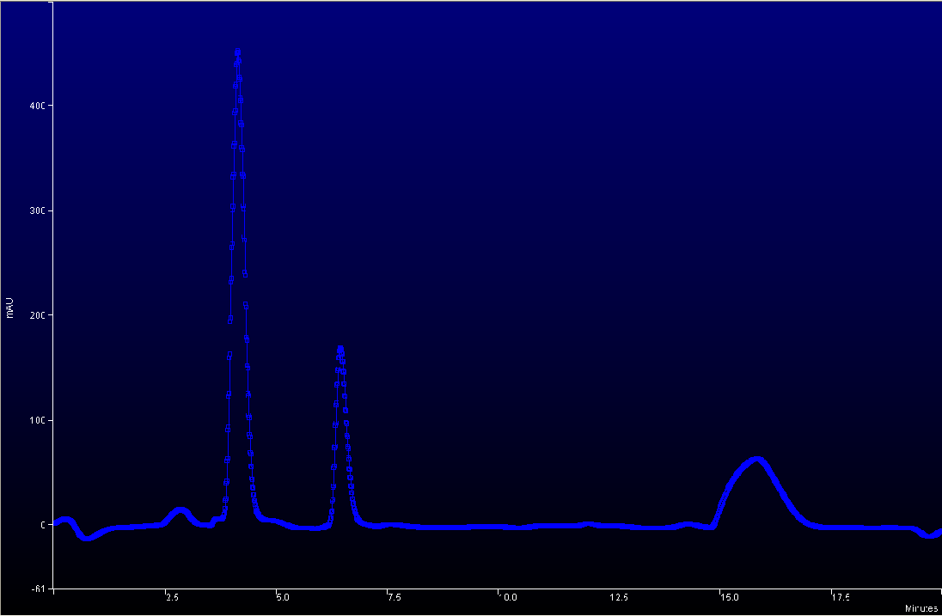
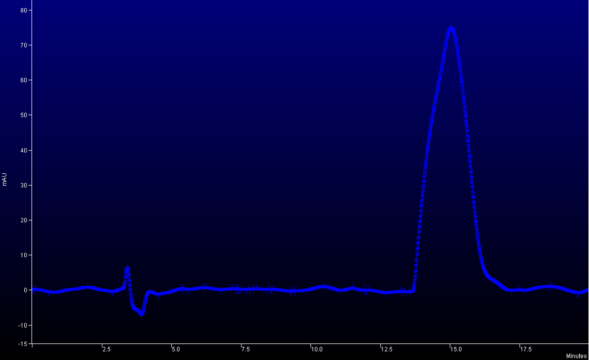
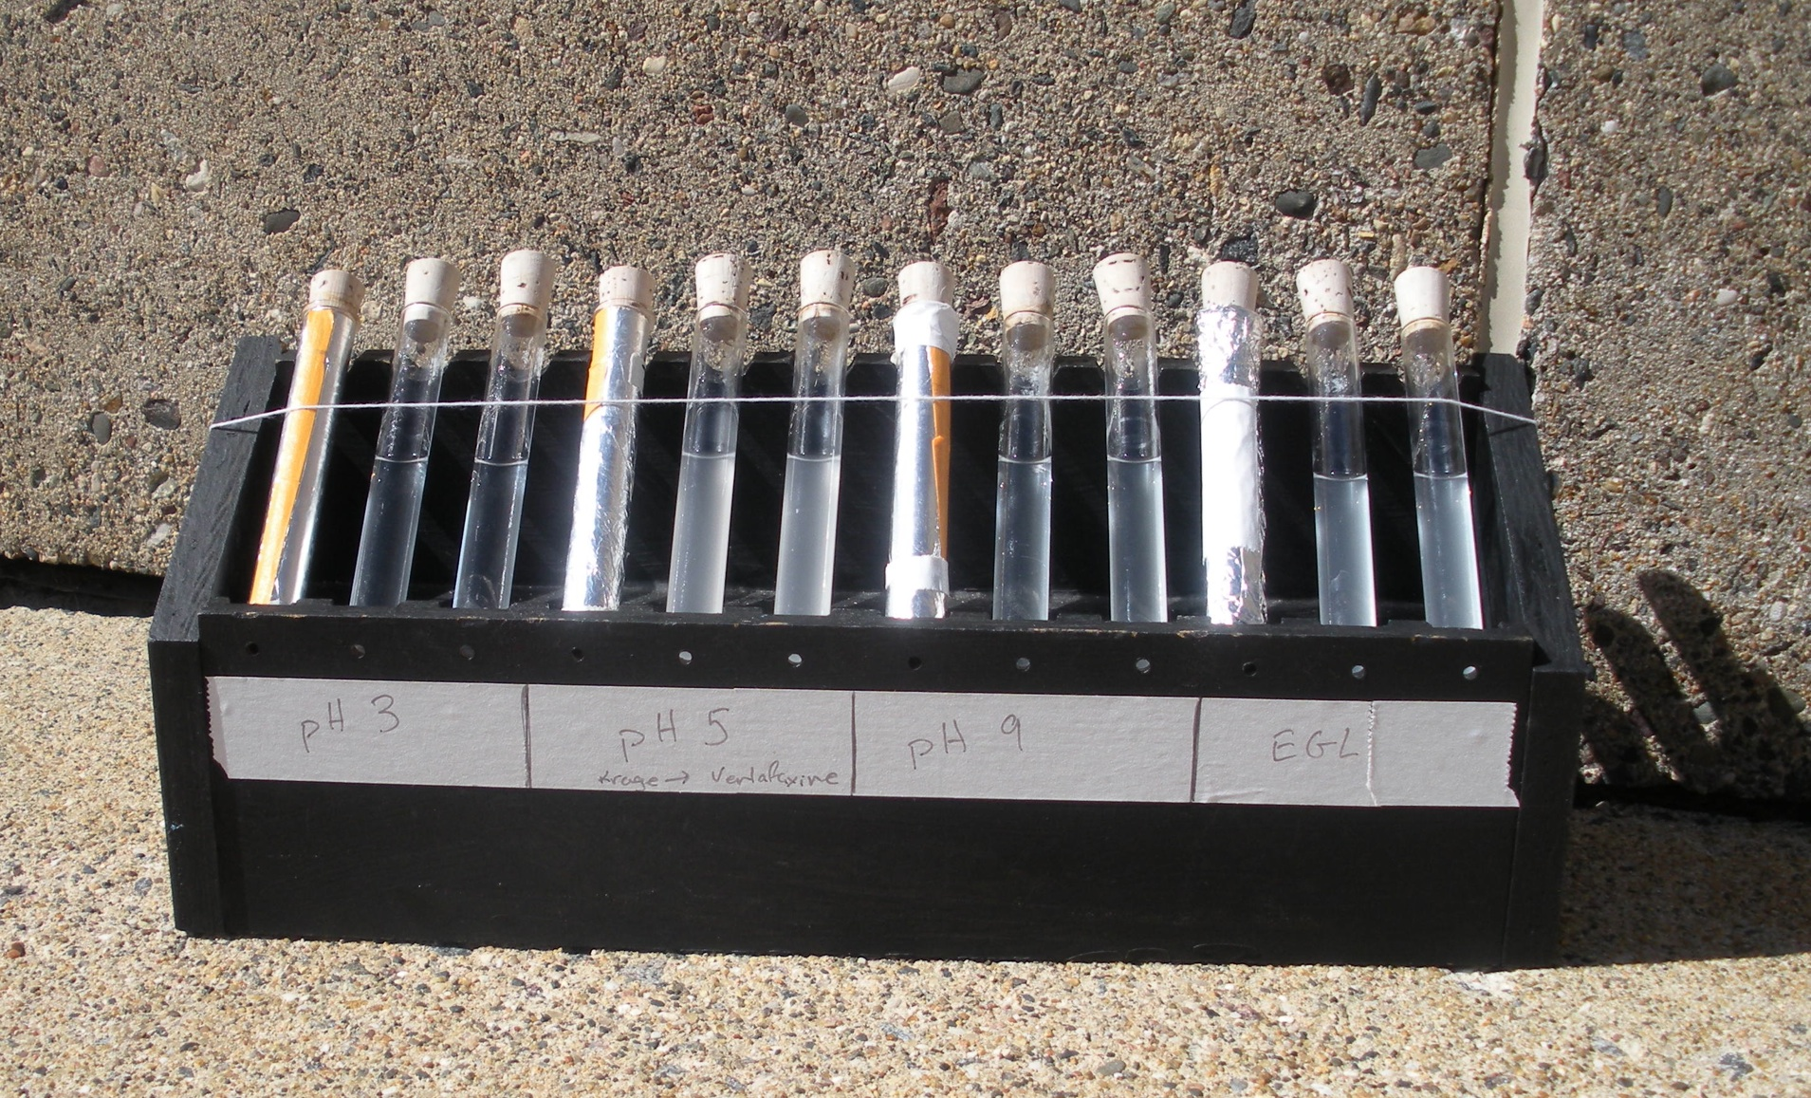
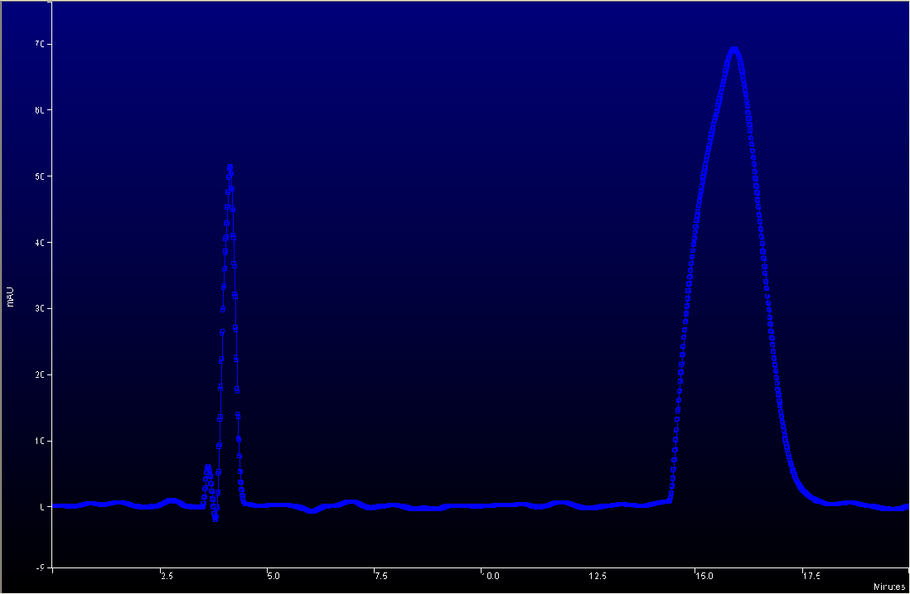
The Photodecomposition of the Antidepressant Pharmaceutical Drug Venlafaxine (Effexor) in Natural Sunlight
Chemistry Department of The College of Saint Benedicts & Saint John’s University
Student Researcher: Benjamin Krage
Advisor: Dr. Mike Ross
hv
III. Experiment Section
IV. Results & Discussion
The 27 hour sample again shows an increased peak area at 3 minutes and a new peak has formed at 7 minutes. The peak area at 15 minutes has decreased slightly to 6500 mAU².
???
An Effexor tablet was dissolved in E-pure water and methanol creating a 10mM solution of Venlafaxine. The solution was filtered to remove the insoluble pill matrix.
An HPLC was used to quantify the amount of Venlafaxine in solution relative to the original 10mM solution. The LC was interfaced with PDA specifically scanning at the 280nm wavelength.
Chromatograms of samples taken at 0 hours, 9 hours, and 27 hours are shown.
The 0 hour sample represents the base concentration of Venlafaxine before there was any sun exposure. The average peak area at 15 minutes is approximately 7300mAU².
Venlafaxine HCl
I. Background
In the past several years pharmaceutical drugs (specifically antidepressants) have begun to be found in lakes and rivers as a new form of pollution due to waste water treatment plants’ inability to remove these drugs from water¹.
In January 2006 Venlafaxine (Effexor) was found in large concentrations relative to other antidepressants when a study was done near a waste water treatment plant in St. Paul, MN¹.
Figure 4. Chromatogram of Venlafaxine solution after 27 hours.
These results show that indeed there is not only some sort of photo-decomposition, but also a stable photo-decomposition product. This product is represented by the growing peaks at 3 and 7 minutes. From this data the rate of decomposition can only be approximated.
Figure 2. Chromatogram of Venlafaxine solution after 0 hours.
II. Purpose
The 9 hour sample shows an increased peak area at 3 minutes and a peak area at 15 minutes that is not significantly different from the 0 hour sample.
This experiment will study the photodecomposition of Venlafaxine in simulated surface water conditions, the goal being to find the decomposition rate of the drug and the isolation of any decomposition products that may form. The results of this experimenting will help decide if either the drug or the decomposition products are harmful, and if so how long they will remain in the environment.
Figure 1. Experimental set up of simulated surface water conditions.
V. Future Work
Trials were run in triplicate. One tube was a control and covered in aluminum foil to block light from reaching it. Two other samples were set up in quartz tubes and exposed to the sun’s light. Samples were taken at approximately 4 hour intervals.
This experiment should be run (in conjunction with an actinometer) long enough that the half-life of the decomposition can be passed. The decomposition products should also be isolated and identified.
Figure 3. Chromatogram of Venlafaxine solution after 9 hours.
(1) Schultz, M.M.; Furlong, E.T. Anal. Chem. 2008, 80, 1756-1762

