Slide 1
Unified Modeling Language
Sequence Diagrams
Chapter 2 (JIA)

Slide 2
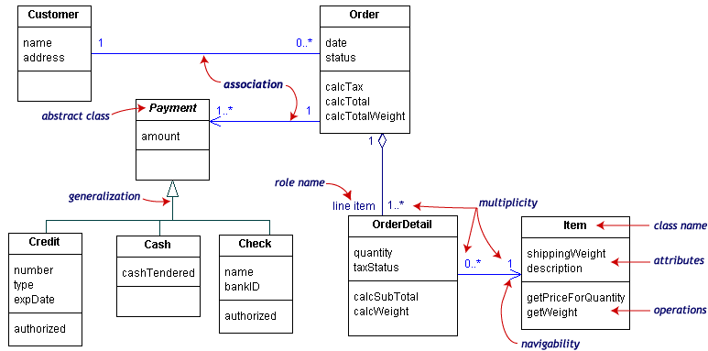
Notes:
Map to classes

Slide 3
Modeling Dynamic Behavior
Class diagrams model the static structure of the system
Use cases capture user requirements (functional ones only)
Here we are concerned with details about functionalities
  Actions done by/on objects
  Interactions among objects
  Order of events

Slide 4
Sequence Diagrams
  Main purpose: Define event sequences that result in some desired outcome.
    Focus not on messages themselves
    Focus on the order in which messages occur
    Communicate:
      What messages are sent between a system's objects
      The order in which they occur.
    X-axis contains the objects involved in the interaction as columns with the object initiating the interaction being the leftmost
    Y-axis represents time in the downward direction

Slide 5
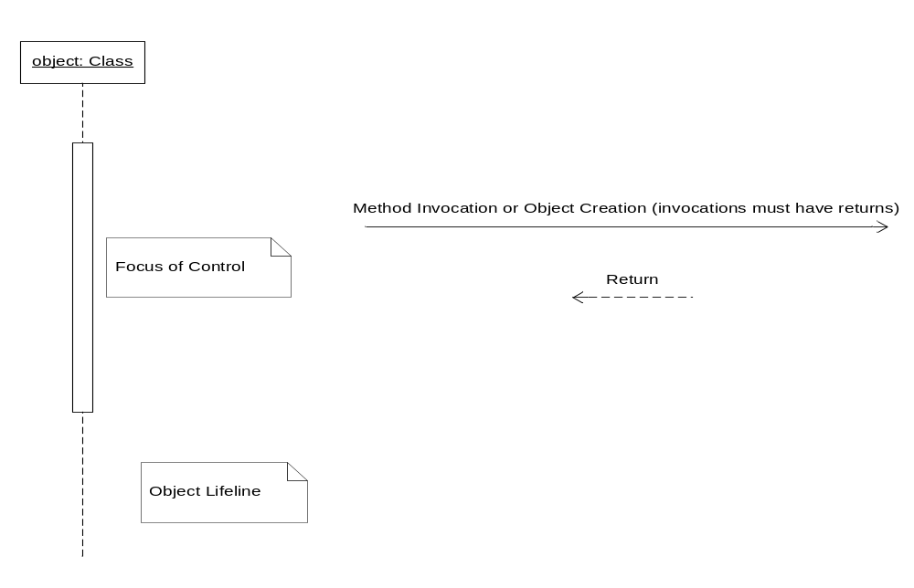
Sequence Diagram
i.e., duration one of the methods of the object is executing

Slide 6
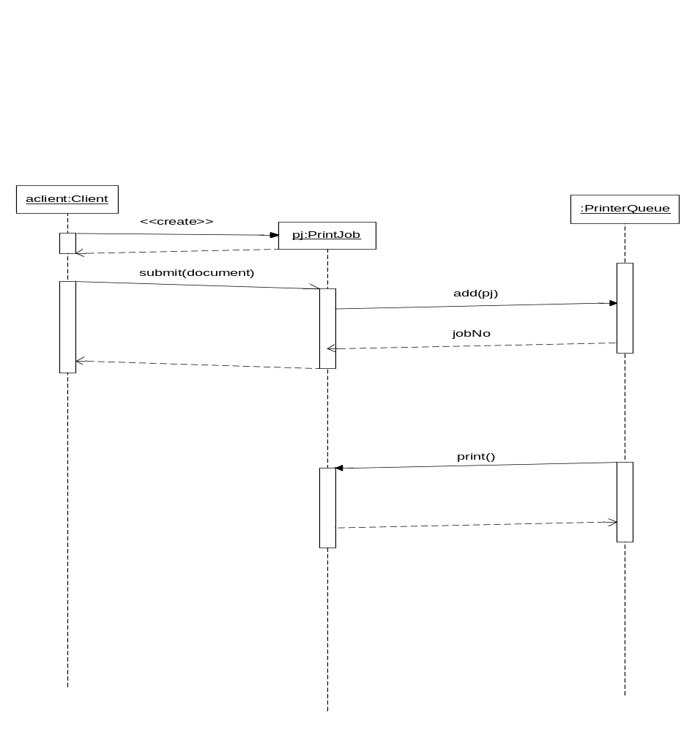

Slide 7
Additional Examples
Example from Practical Object-Oriented Development with UML and Java---Chapter 7
  Scenario 1: Warm food for 1 minute
  Scenario 2: Warm food for 1 minute and then add a another minute as food is cooking
  Scenario 3: Warm food for less than 1 minute (i.e. remove food before timer is times out)

